Slide 1
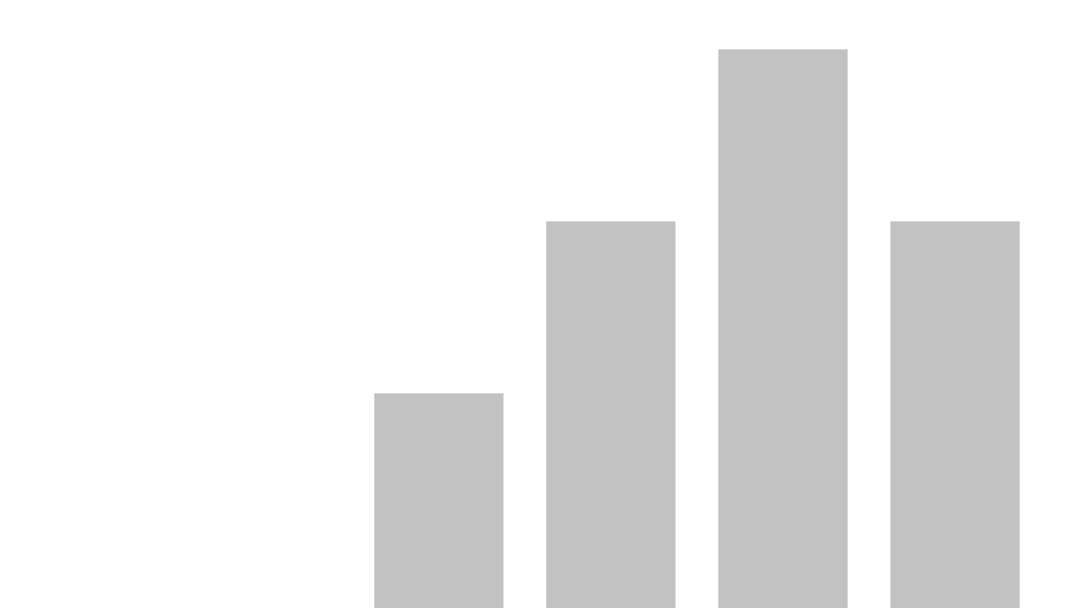


Hospital Capacity Analysis
For COVID 19
View in Power BI
Last data refresh:
5/6/2020 9:53:49 PM Eastern Standard Time
Downloaded at:
5/6/2020 10:01:03 PM Eastern Standard Time

Slide 2
Project and Data Description
This project aims to analyze hospital capacity in united states when the coronavirus patients reach 20% of the population by state.
Health Systems Researchers at Harvard Global Health Institute (http://globalhealth.harvard.edu/) have built a model on bed capacity and offers localized estimate of beds that would be needed in the coming months
The model assesses hospital capacity over six, twelve, and eighteen months, if 20%, 40%, or 60% of the population contracts COVID-19.
For more information on methodology and how rates are calculated, see: https://globalepidemics.org/our-data-guide/

Slide 3
Breakdown of Visuals
Story 1 : Shows Hospital Beds with respect to Available adult and 65+ population
Story 2: Hospital Bed Capacity Analysis when 20 percent of the population, which seems plausible in the near future get affected.
Story 3: Hospital and ICU Availability Analysis under high impacted states from Story 2.
Story 4 : Hospital Search in Each State to manage availability

Slide 4
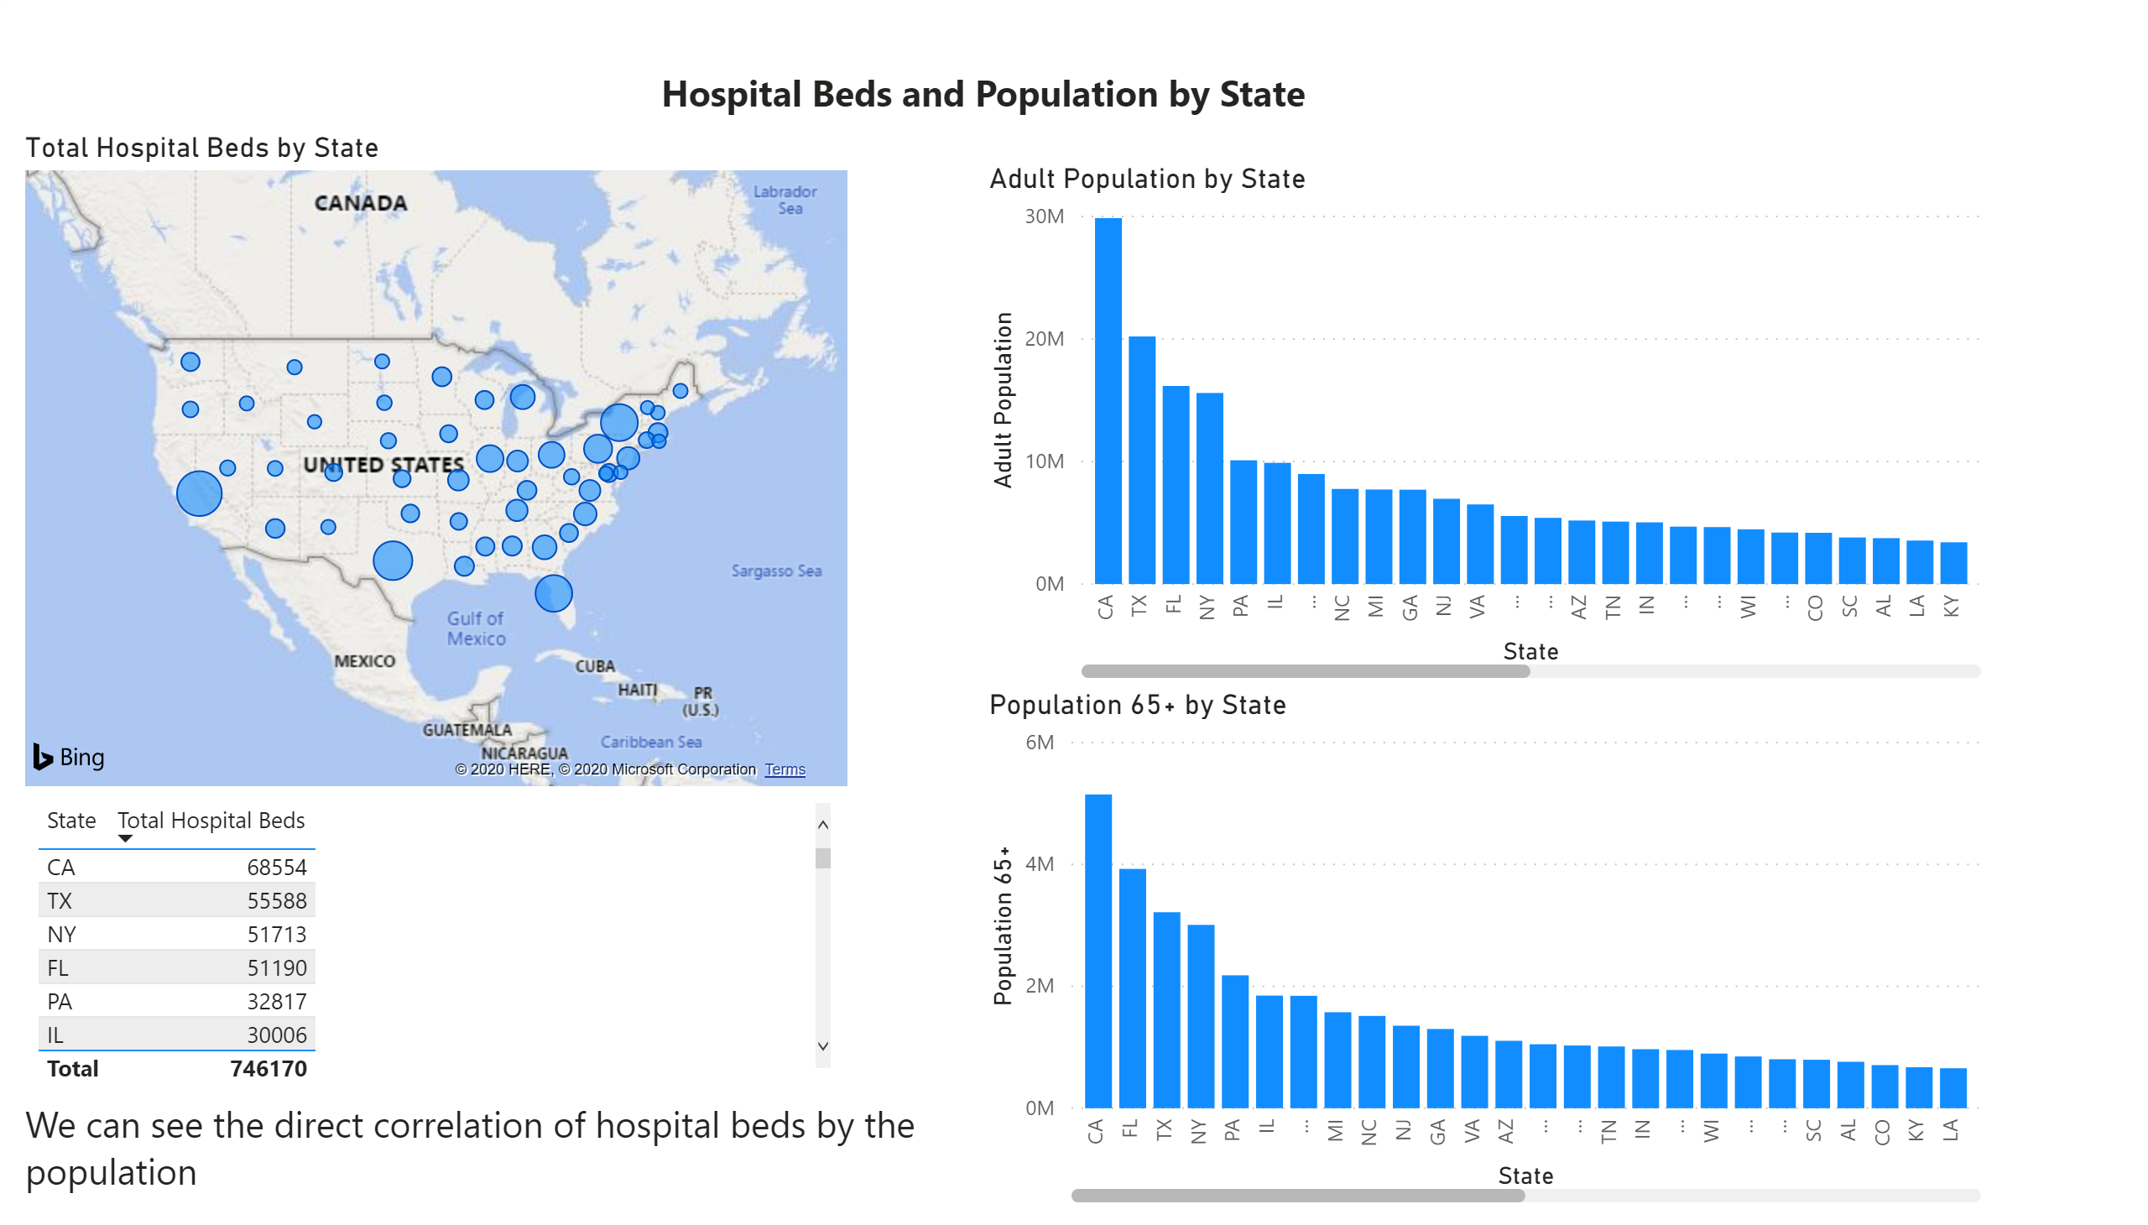

Slide 5
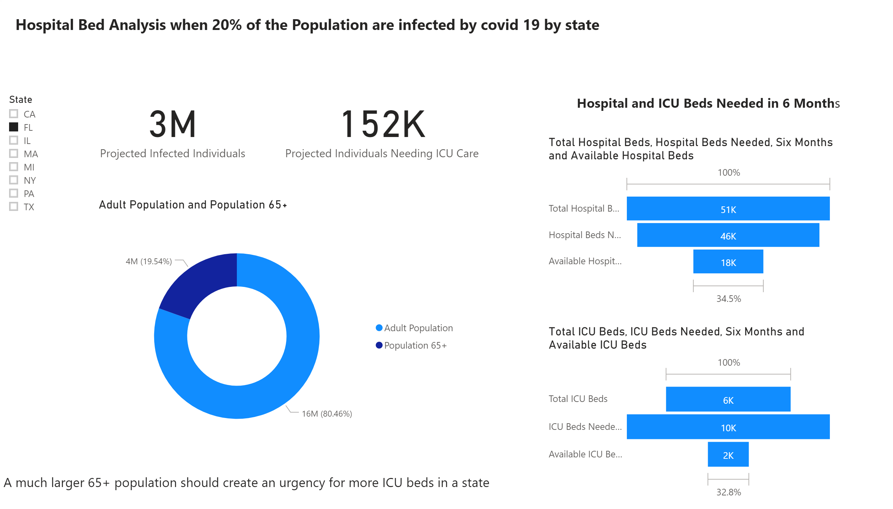

Slide 6
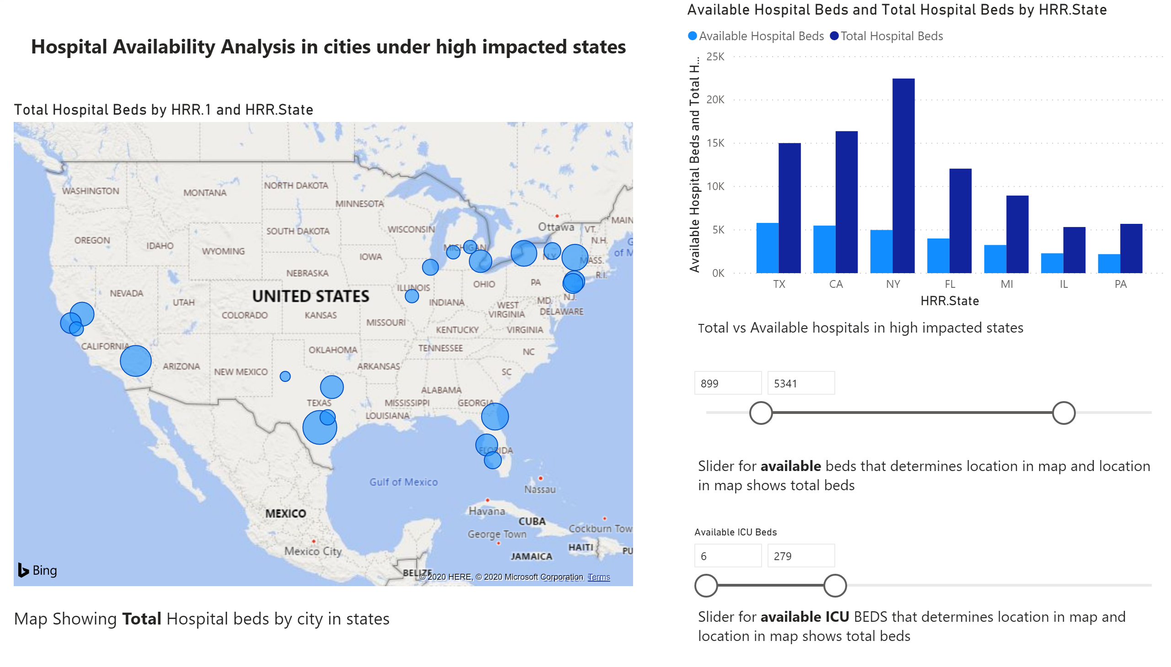

Slide 7
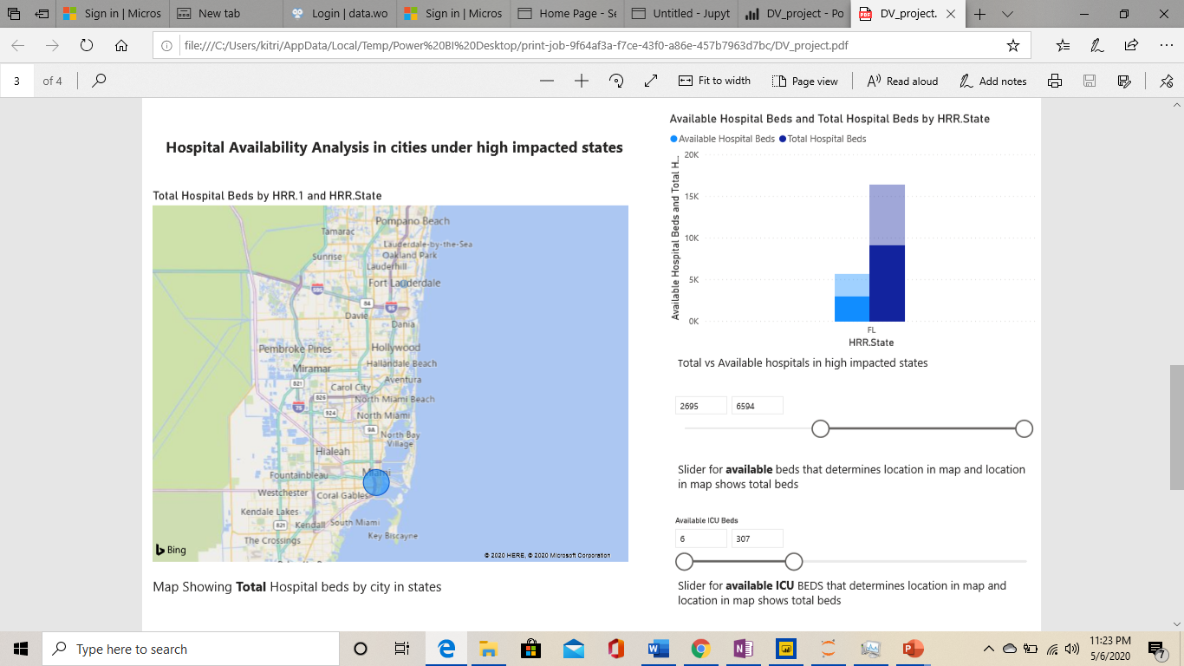
A Story and inference

Slide 8
Insights
As we have seen, Florida has highest number of Adult to 65+ ratio
For this much larger population of 65+, there are very meager number of ICU’s
In the above visual we can see that Miami has a highest number of beds in florida and at the the same time lowest number of ICU’s
Next slide shows story on top of it to explore each hospitals in a state and then to continue to the story

Slide 9
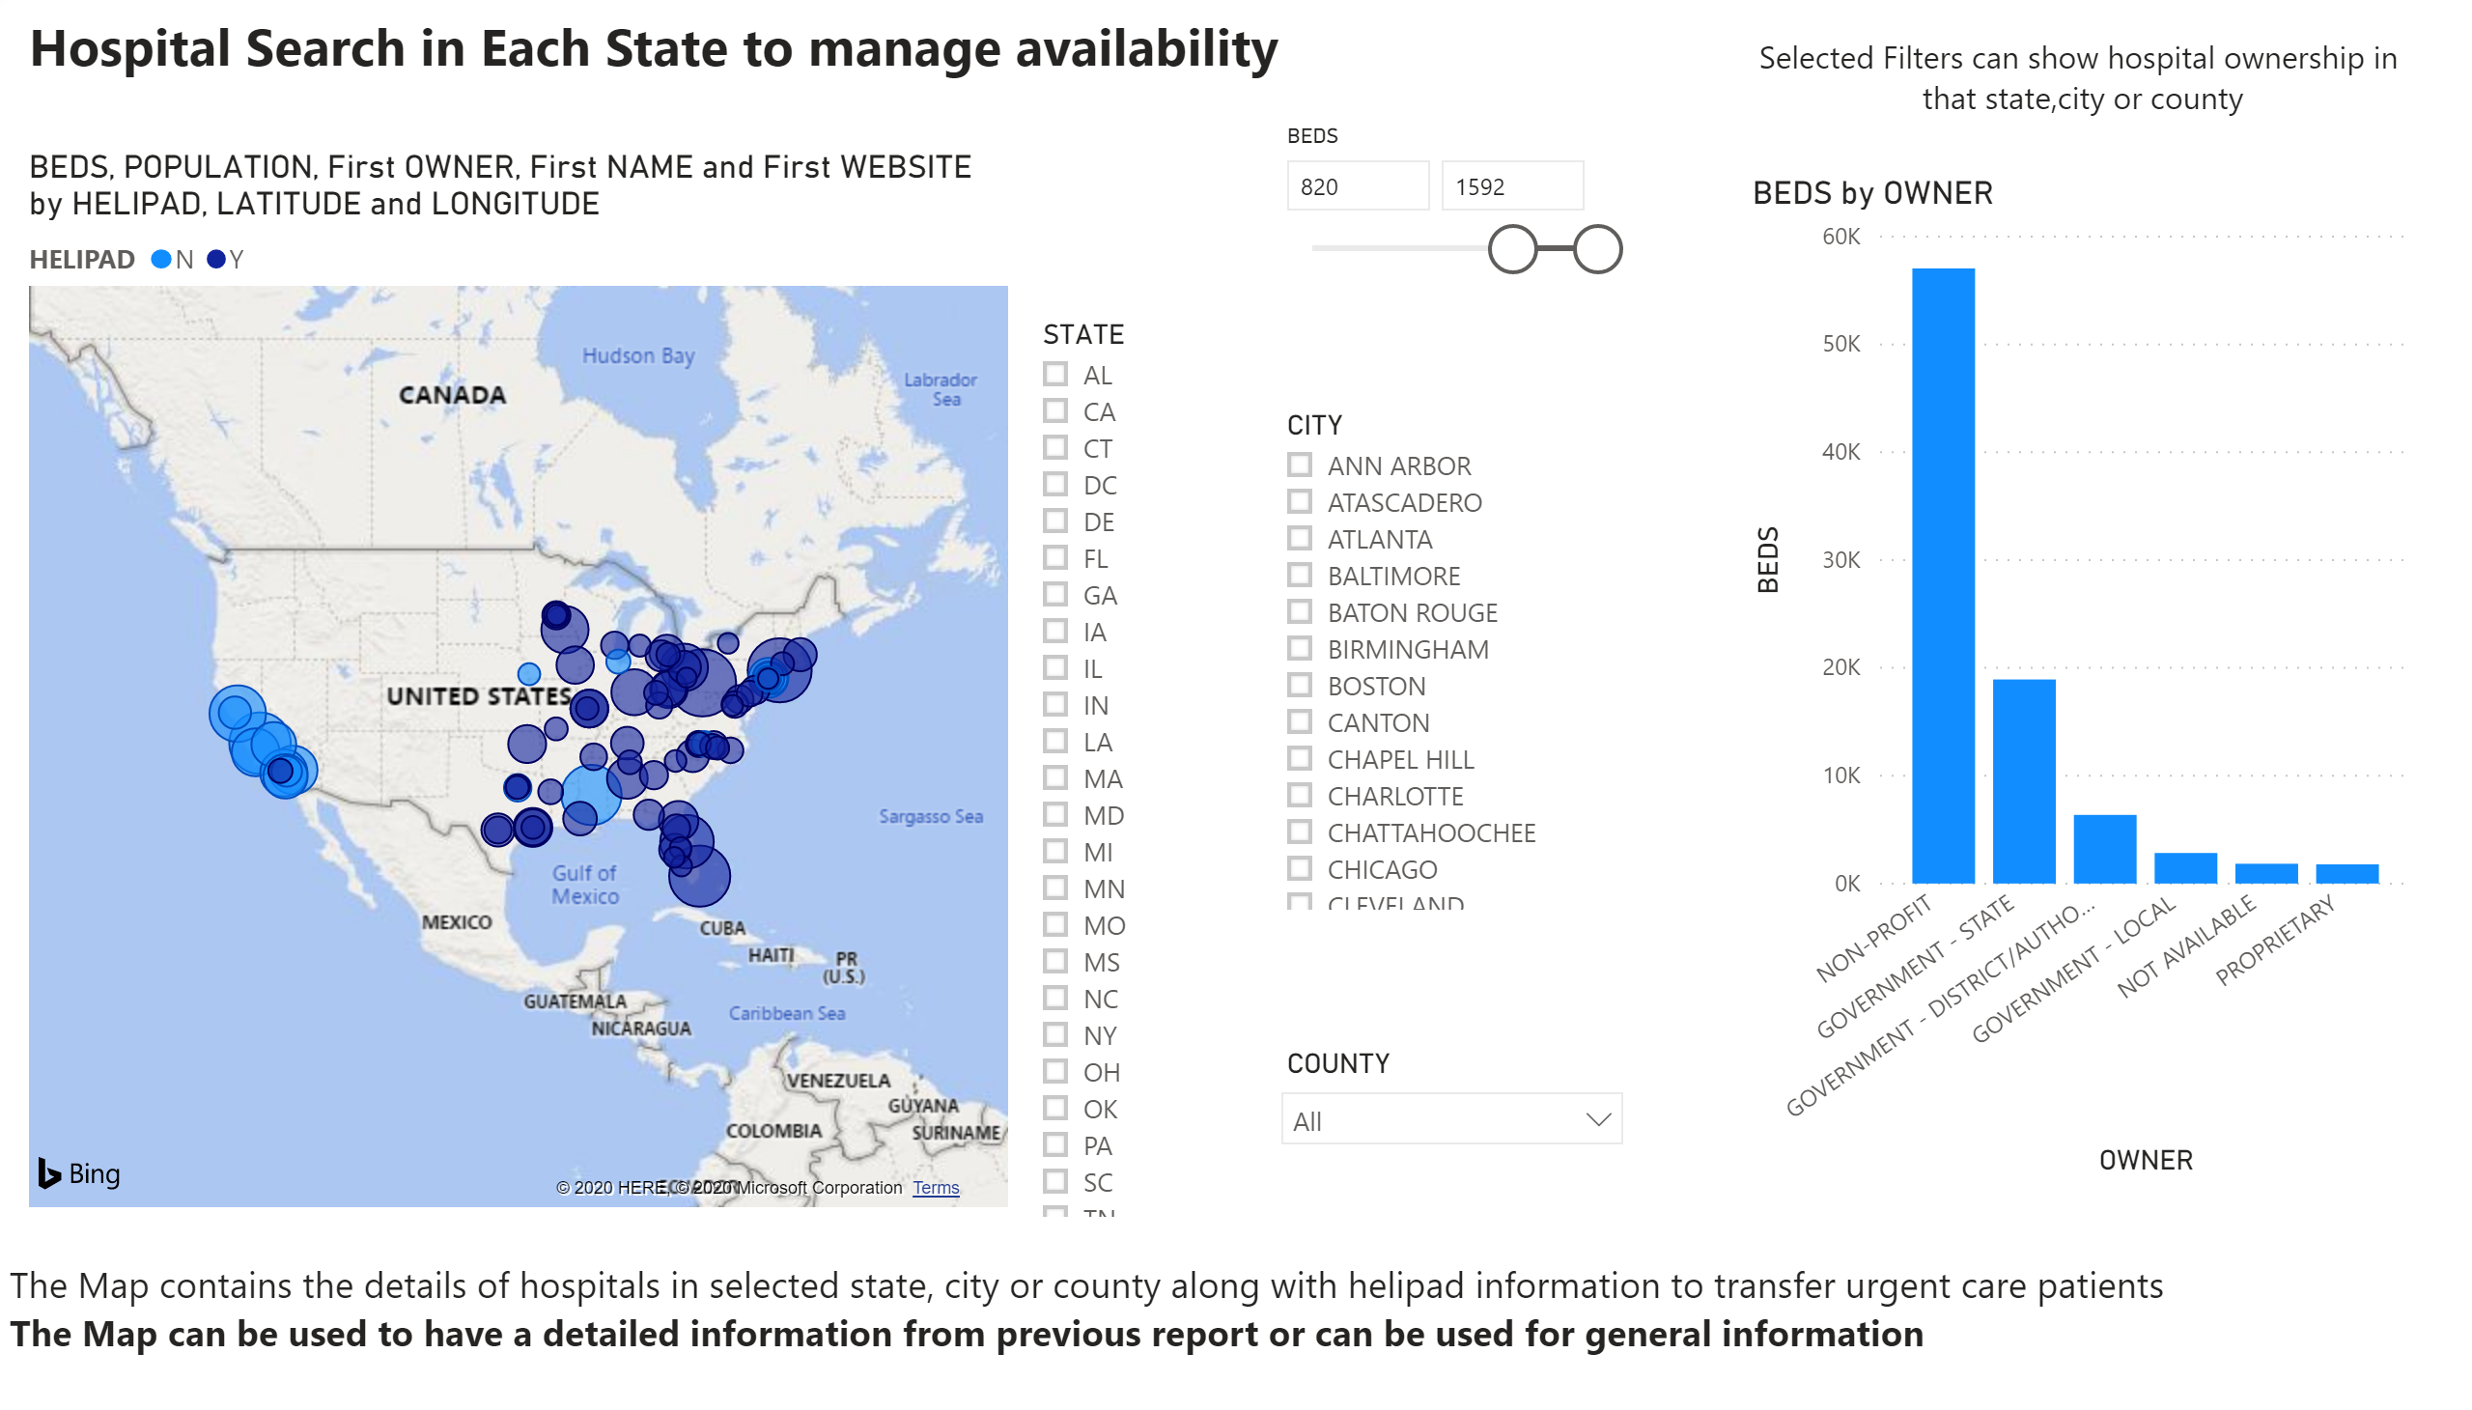

Slide 10
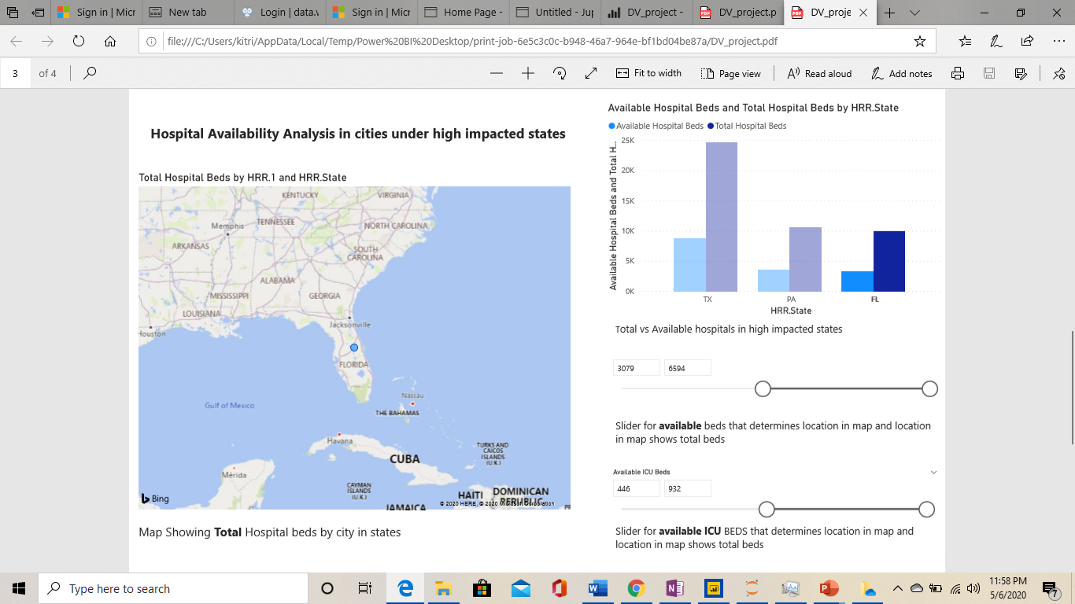
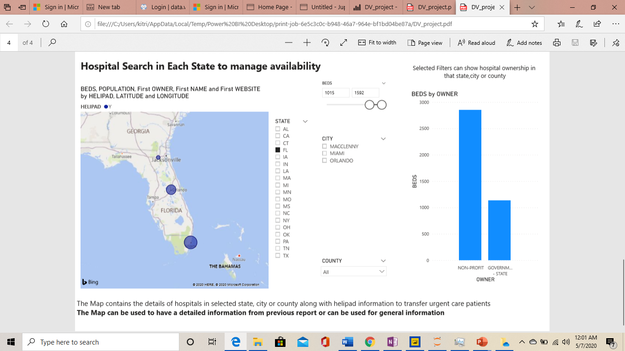
A story and inference… Contd..

Slide 11
Conclusion
As it can be seen, Orlando has high number of ICU beds including total beds.
On Situation getting worse, People needing ICU Care can be taken to Orlando’s hospital from Jackson’s memorial Hospital in Miami via the air route as both hospitals have helipads.
The above visuals can be used for analysis of other states or general purpose information. Moreover, other types of analysis can be done.

